Slide 1

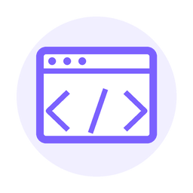

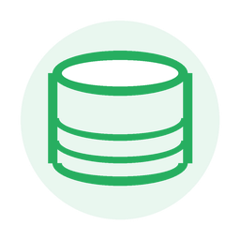
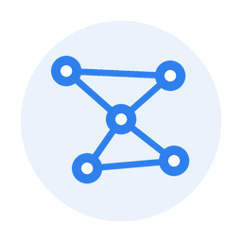

TEACHING SLIDES
Information Systems
Components & Architecture
People
Software
• Big picture: how people, data, software, hardware, and networks work together
• Modern architecture: client, frontend, network, backend, server, and database
• Practical lens: browser, UI, CLI, apps, HTTP/TCP, programming, and algorithms
Information System
Server
Data
Network
Security
01

Slide 2

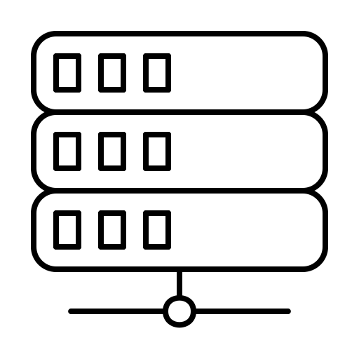



Presentation Layer
/ Frontend
/ Client
Authenticate user e.g. WeChat Sign-in
Data Layer
/ Backend / Server
Users 1
Local Database
Command Line Interface (CLM)
Relational Database
Static files like JSON
Application Layer
/ Backend
/ Server
Users 2
Cloud storage
Laptop Browser
Documents / Blobs
Users 3
Mobile App
Logs
events
audit trails
Users 4
APIs to other Servers
from other parties
WeChat mini
02

Slide 3


COMPONENTS
Major components of an information system
These pieces work together; none is useful in isolation.
Hardware
Software
Data
Physical devices: computers, servers, routers
Programs, operating systems, enterprise apps
Raw facts organized into useful information
People
Processes
Networks
Users, managers, analysts, IT specialists
Rules, workflows, procedures, approvals
Internet, Wi-Fi, LAN, APIs, communication links
Security
Access control, encryption, backups, audit logs
Useful information emerges when components are coordinated.
03

Slide 4

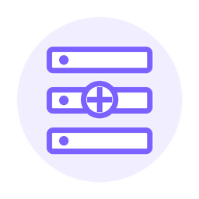
ARCHITECTURE
Common architecture: layered system
A three-tier model plus network communication.
Presentation Layer / Frontend
Layer responsibilities
UI, CLI, browser, mobile app, desktop app
Frontend
collects input + shows output
Network Layer
HTTP/HTTPS, TCP/IP, APIs, internet/LAN/Wi-Fi
Network
moves requests + responses
Application Layer / Backend
Backend
applies rules + runs algorithms
Business logic, programs, algorithms, authentication
Data
stores facts + history
Data Layer
Database, files, cloud storage, data warehouse, logs
Most real systems use variations of this model.
04

Slide 5

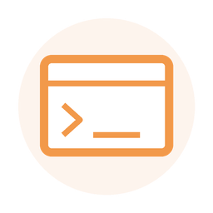


CLIENT SIDE
Client side: where users interact
A client is any tool that sends requests and displays responses.
UI
CLI
Visual interface: buttons, forms, menus, dashboards
Text interface: commands, scripts, automation
Browser
Apps
Web client: Chrome, Edge, Safari, Firefox
Mobile or desktop software installed by users
Different clients can use the same backend and data layer.
05

Slide 6

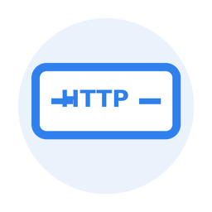
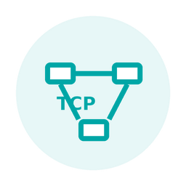
CLIENT/SERVER
Server/client model: request and response
The client asks; the server processes; the client receives the result.
Request
Client
HTTP/HTTPS
TCP/IP
Server
• Runs UI/CLI: captures user actions
• Sends requests: asks server for work
• Displays responses: shows results
Network communication
• Receives requests: from many clients
• Runs backend: logic + algorithms
• Returns responses: data, page, result
Response
06

Slide 7
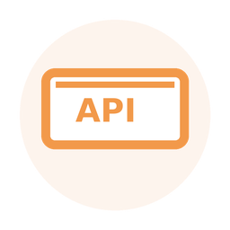
NETWORK
Communication: HTTP, TCP/IP, and APIs
Protocols define how systems exchange messages reliably and securely.
Protocol stack
Example web exchange
HTTP / HTTPS
User wants a page, data, login, or action
Request: GET /products/42
APIs
Defined endpoints between apps and servers
Backend: validate -> compute -> query data
TCP/IP
Packets move across networks and arrive reliably
Response: product details + status code
HTTPS adds encryption and identity protection around HTTP.
07

Slide 8

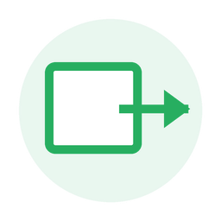

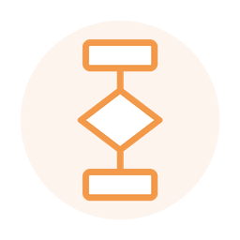
BACKEND
Backend: programming, algorithms, and business logic
Backend code turns requests into trusted actions.
Authenticate user e.g. WeChat Sign-in
Receive request
Read/write data
Return response
APIs to other Servers
from other parties
Programming
Algorithm
Business logic
Writing instructions that tell the system what to do.
Step-by-step method for solving a problem.
Rules for prices, approvals, inventory, and workflows.
08

Slide 9


DATA
Data layer: memory of the system
Data stores keep facts, history, transactions, and evidence.
Database
Cloud storage
structured records
large objects + backups
Data Layer
Data warehouse
Logs
analytics + history
events + audit trails
Create - Read - Update - Delete | Backup - Restore - Audit
09

Slide 10
FRONTEND/BACKEND
Frontend and backend: what users see vs. what systems do
A useful distinction for designing, troubleshooting, and explaining systems.
Frontend
Backend
• User-facing: screens, forms, buttons, commands
• Runs in: browser, mobile app, desktop app, terminal
• Main job: collect input and present output
request
• System-facing: servers, code, APIs, services
• Runs on: server infrastructure or cloud platform
• Main job: enforce rules and process data
response
UI / CLI / Browser / Apps
Server / APIs / Algorithms / Database
10

Slide 11

EXAMPLE
Example: online shopping information system
Follow one customer action through the whole architecture.
Customer
App / Browser
HTTPS request
Backend server
Database
Outputs
chooses item
clicks Buy Now
sent over TCP/IP
processes order
updates records
receipt + report
Backend algorithm for Buy Now
1. Validate cart
2. Check inventory
3. Calculate price
4. Process payment
5. Save order
6. Send confirmation
The same information system supports customer service, finance, inventory, and management reporting.
11

Slide 12

WRAP-UP
Summary: connect the terms
Use the architecture map to place each concept.
Network
Server / Backend
Client / Frontend
HTTP/HTTPS, TCP/IP, APIs
programs, algorithms, business logic
UI, CLI, browser, apps
Information System
Data Layer
Information System
database, files, cloud, logs
Quick check
people + process + technology + data
Can you trace a login, purchase, or report request from client to data and back?
12

